Slide 1
The Magic Tree
Writing to Describe

Slide 2
Question Time!
What do you think has caused the destruction around the tree?
Why has this tree survived?
If you walked through the portal, what would happen to you? What would you see?
If this was a portal to another world, would you go through it or stay on earth, even if you had no idea what could happen?
Is it good to take risks? Are some risks riskier than others?
Portal – a doorway or other entrance

Slide 3
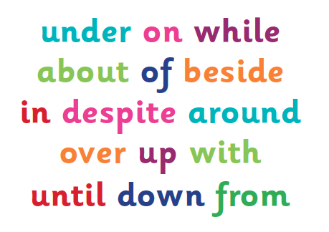
Sentence Challenge!
A preposition is a word that shows the relationship between one thing and another.
It may tell you where a thing is in relation to something else. E.g. The green, shining door appeared inside the tree.
It may tell you when something is in relation to another event. E.g. The portal would not close until the electrical storm had ended.
Can you write 3 sentences, connected to this image, that contain prepositions?

Slide 4
Sick Sentences!
These sentences are ‘sick’ and need help to get better. Can you help?
The big tree had bark and leaves. Inside the tree were stars and the moon.

Slide 5
Perfect Picture!
Imagine you have just walked through the open portal and into the world inside the tree.
1. Draw what you can see
2. Now describe what you
can see in 100 words

Slide 6
Story Starter!
The tree was all that remained. A solitary figure, it stood there in defiance of the destruction surrounding it. The bark had begun to peel away, one piece at a time, joining the wreckage of other trees that lay scattered across the scorched earth.
This tree was different to the other trees. It contained magic. It contained hope…
Can you continue the story? What is so different about this tree? What has happened to the other trees around it?

Slide 7
TASK

