Slide 1
Original Idea for this potions lesson, (which actually inspired the whole ‘Harry Potter in Transition’ project) along with the powerpoint that has been tweaked/adapted and used here, came from a TES resource by Amanda Goddard.
https://www.tes.com/teaching-resource/harry-potter-s-potions-a-ratio-lesson-powerpoint-6012867
Thank You Amanda!

Slide 2
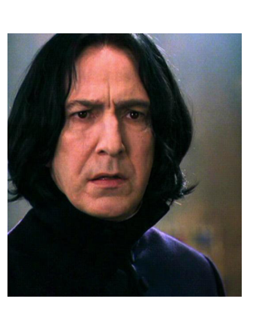
in transition!
Today’s Lesson is all about Potions.
Potions WARNING!
Imagine you are a pupil in Snapes Potions class…..
Ingredients are listed, but even if Muggles would gather and brew the correct herbs, insects, and other materials (some of which are poisonous), they would not be able to create the potions listed here. The most important ingredient to any magic is the magical power of the wizard creating the effect.
Don’t try this at home!

Slide 3
Imagine you are a pupil in Snape’s Potions class…..
Forgetfulness Potion
(Makes enough for 5 people)
10 tablespoons of powdered Griffin claw
2.5 tablespoons of Salamander blood
30 rat tails
Discuss for 90 seconds with a partner:
How do we make an ingredient list for
10 people? b) 1 person?
Can you do any the calculations in your head?
Be ready to share your ideas after 90 seconds!
in transition!

Slide 4
Answers:
Forgetfulness Potion
(Makes enough for 5 people)
10 tablespoons of powdered Griffin claw
2.5 tablespoons of Salamander blood
30 rat tails
Did you get these answers?
How do we make an ingredient list for
10 people? Double everything.
20 tbs griffin claw
5 tbs salamander blood
60 rats tails
b) 1 person divide all by 5
2 tbs griffin claw
0.5 tbs salamander blood
6 rats tails
Now have a look at the shrinking and wit-sharpening potions on the next slide
in transition!

Slide 5
Ingredients: 40 ground Scarab beetles
2 tablespoons Armadillo bile 1 ginger root 20g of Knotgrass (makes 10 doses)
Imagine you are a pupil in Snape’s Potions class…..
Wit-Sharpening Potion
Shrinking Potion
Ingredients:
5 chopped daisy roots,
3 skinned shrivelfig
1 sliced caterpillar
one rat spleen
dash of leech juice
(Makes 2 Doses)
Can you work out how much of each ingredient we will need to make for….
(see your booklet!)
in transition!

Slide 6
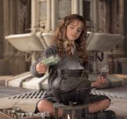
Task: Your Turn!
Design your own potion
Decide what it is for, it must have at least 6 ingredients – use your imagination!
Record the recipe for 5 people
Show the quantities needed for 1, 10 and 200 people
(O.W.L Level)
Present your work neatly adding illustrations if time!
Triwizard Challenge
Once you have designed your potion. Estimate in g and Kg each of your ingredients. Using these, can you work out the amount of each ingredient in your recipe as a fraction, decimal and percentage of the whole Potion? (N.E.W.T. Level)
in transition!

Slide 7
Task: Your Partners Turn!
Check out their potion
Read through your partner’s potion.
Check you agree with their calculations for 1, 10 and 20 people – discuss if you do not!
Discuss, if this was a normal numeracy lesson, what the teacher would have put on the board for WALT or a learning objective – Was there a learning outcome? What is this topic called?
Be prepared to feedback to the group.

